Slide 1


Alabama State Department of Education
Certificate Issues & Procedures
Presented by Susan Crowther, Esq.
Associate General Counsel, Alabama Dept. of Education

Slide 2
Authority to Take Action
Ala. Code § 16-23-5 (1975)
Ala. Code §§ 16-22A-1, et. seq (Child Protection Act of 1999, as amended in 2002)
Alford v. Ingram, 931 F. Supp. 768 (M.D. Ala. 1996)

Slide 3

Legal Authority to Revoke
Alabama Code § 16-23-5
The State Superintendent of Education may revoke any certificate issued under this chapter when the holder has been guilty of immoral conduct or unbecoming or indecent behavior.

Slide 4

Legal Authority to Conduct Criminal History Background Checks
Alabama Code §§ 16-22A-1, et seq
CHILD PROTECTION ACT

Slide 5
Alford Factors
The likelihood that the conduct may have adversely affected students or fellow
teachers,
The degree of such adversity anticipated,
The proximity or remoteness in time of the conduct,
The type of teaching certificate held by the party involved,
The extenuating or aggravating circumstances, if any, surrounding the conduct,
The praiseworthiness or blameworthiness of the motives resulting in the conduct,
The likelihood of recurrence of the questioned conduct,
And the extent to which disciplinary action may inflict an adverse impact or chilling effect upon the constitutional rights of the teacher involved or other teachers.

Slide 6

Administrative Procedures
Alabama Administrative Procedures Act, Ala. Code §§ 41-22-12 through 41-22-21 (1975)
Ala. Admin. Code r. 290-3-2-.04
Bice v. Taylor, 157 So.3d 161 (Ala. Civ. App. 2014)
Notice and an opportunity to be heard

Slide 7

SEXUAL MISCONDUCT BETWEEN SCHOOL EMPLOYEES AND STUDENTS

Slide 8

Criminal laws pertaining to specific sexual misconduct
Act 2010-264 - immediate revocations for certain offenses
Act 2010-497 - criminalizing sexual activity between teacher and student
Act 2016-354 - criminalizing “sexting” students

Slide 9
Act 2010-264

Slide 10
Fincher Law - History
Former Representative Fincher (Washington County) proposed a bill that would automatically revoke teaching certificates when the holder was convicted of certain offenses; some of which fall under the Community Notification Act preventing the individual from being employed by a school.

Slide 11
Inspiration for this law
Charlene Schmitz was a teacher in Washington County
She solicited her daughter’s boyfriend, a student of Mrs. Schmitz’s, for sex using a computer and the cell phone she bought him
She collected over $140,000 in salary while her case was pending
She is serving a ten year sentence in federal prison

Slide 12
Schmitz Case
Because Schmitz was convicted of a crime that would not allow her to be employed by a school, it made sense to have a law that would immediately revoke the holder’s certificate and terminate the holder’s employment
This law does that

Slide 13
Crimes included in Act 2010-264
Class A Felonies (including rape, murder, kidnapping, or robbery)
Murder
Rape
Sodomy
Sexual Torture
Sexual Abuse
Enticing a Child to Enter a Vehicle, etc. for Immoral Purposes

Slide 14
Additional Crimes
Promoting Prostitution
Violation of the Child Pornography Act
Kidnapping a minor
Incest
Transmitting Obscene Material
Facilitating Solicitation of Unlawful Sexual Conduct with a Child
Electronic Solicitation of a Child

Slide 15
Additionally…
Any crime committed in any jurisdiction which if committed in this state under the law existing at the time would constitute an offense listed previously
Any sex offense involving a child under the age of 12 or any offense involving child pornography
Any crime committed in any jurisdiction with the same elements as those previously listed

Slide 16
And finally…
Any crime not listed in this subsection involving endangerment to the health, safety, or welfare of a child that may be created on or after the effective date of the act adding this subdivision
i.e., the “Newton law”

Slide 17
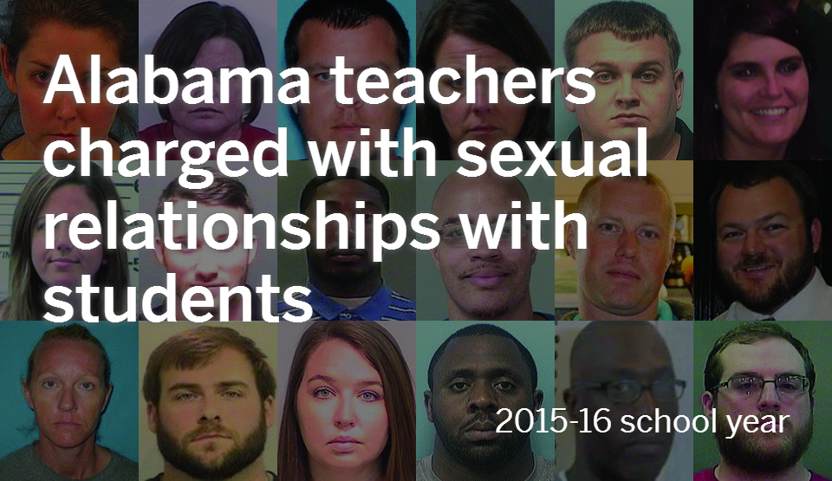
Act 2010-497
(Sexual Offenses Involving a Student)

Slide 18
Act 2010-497
The law was sponsored by the late Senator Demetrius Newton.
It criminalizes school employees having sex with students under the age of 19
Previously it was only illegal to have sex with students under the age of consent (note that consent is not a defense under this law)
While the Department prosecuted cases involving this misconduct, the victim was sometimes unwilling to cooperate

Slide 19
Act 2010-497
Part 1 - Sexual acts or deviant sexual intercourse with a student under the age of 19 is a Class B Felony
Part 2 - Sexual contact – including touching intimate areas for sexual gratification – or soliciting or harassing the student to perform a sex act is a Class A Misdemeanor

Slide 20
How these laws have helped
A number of certificates have been automatically revoked as a result of 2010-264.
With Act 2010-497 in place, the Department has seen convictions resulting in automatic revocations but also when there is a plea deal, one of the terms is often that the individual must surrender his or her certificate

Slide 21
Act No. 2016-354 (Revisions to the School Employee Sex Act law)

Slide 22
Additions to Ala. Code § 13A-6-80
In 2016, the Act was amended to add that it applied to adult volunteers in positions of authority over students
It clarified that the law pertains to those who have contact with students in their official capacity as school employees
Sexual contact (as defined in 13A-6-60(3)) was made a Class C Felony
Solicitation was added as a Class A Misdemeanor

Slide 23
Requirement to Report

Slide 24
Ala. Admin. r. 290-3-2-.04(2)
“Each superintendent shall submit to the Alabama State Superintendent of Education within ten calendar days of the decision, the name and social security number of each employee holding an Alabama certificate or license who is terminated, or nonrenewed, resigns, or is placed on administrative leave for cause, and shall indicate the reason for such action. Superintendents shall provide personnel records and all investigative information immediately upon request by the Alabama State Superintendent of Education. Superintendents shall not be required to report teachers who are nonrenewed without cause. Failure to comply may result in disciplinary action against the employing superintendent.”

Slide 25
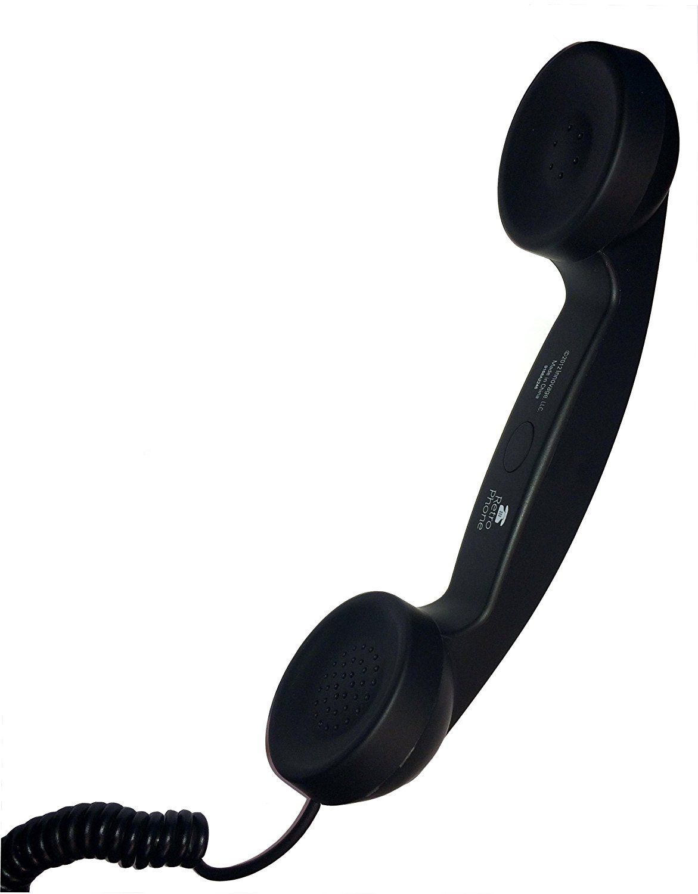
Events that trigger the requirement to report
a person’s employment is terminated for cause
his contract is non-renewed for cause
he resigns “for cause” (under suspicious circumstances)
or is placed on administrative leave for cause

Slide 26

Questions?

